Slide 1
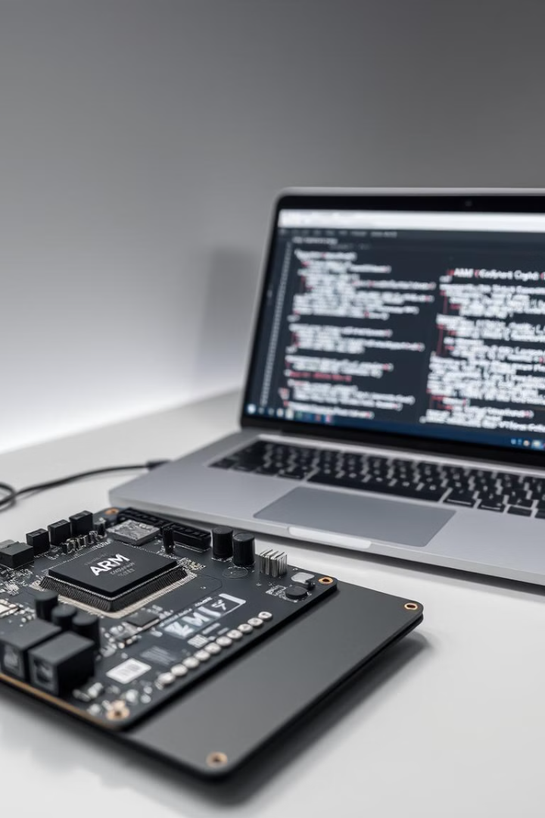

ARM Assembly Language: Basics and Programming Techniques
ARM assembly language is a low-level programming language that provides direct control over a processor's hardware. It's particularly useful for tasks requiring high performance, small memory footprint, or direct hardware interaction.
Presented by
TEAM 4

Slide 2
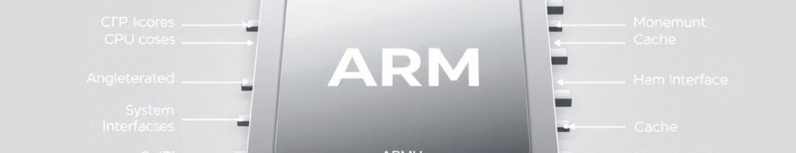

Introduction to ARM Architecture
1
RISC Design
2
Low Power Consumption
3
Widespread Adoption
The ARM architecture follows a Reduced Instruction Set Computer (RISC) design, providing efficient and streamlined processing.
ARM processors are renowned for their energy-efficient operation, making them ideal for mobile and embedded systems.
ARM architecture is ubiquitous, powering a vast array of devices, from smartphones to industrial controllers.

Slide 3

Instruction Set and Addressing Modes
Instruction Set
Addressing Modes
Instruction Encoding
The ARM instruction set comprises a comprehensive collection of data-processing, memory access, and control transfer instructions.
ARM supports various addressing modes, including immediate, register-based, and PC-relative, providing flexibility in memory access.
ARM instructions are encoded in a compact 32-bit format, optimizing for code density and efficient memory utilization.

Slide 4

Registers:
ARM has 16 main general-purpose registers (R0-R15), where:
R0-R12:
General-purpose registers.
R13 (SP):
Stack pointer, pointing to the current top of the stack.
R14 (LR):
Link register, which stores the return address for function calls.
R15 (PC):
Program counter, holding the address of the next instruction.

Slide 5
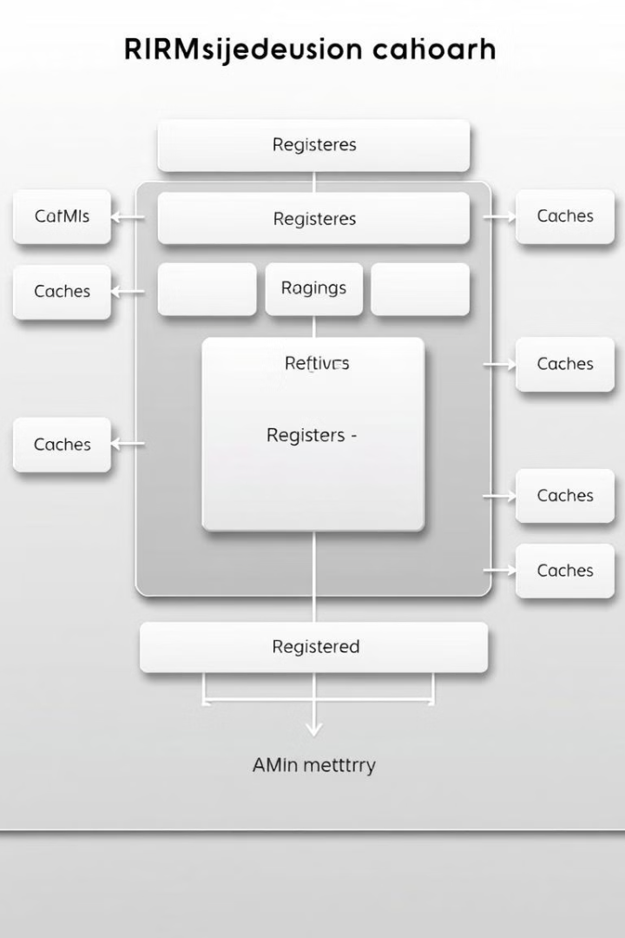

Register Organization and Memory Hierarchy
1
General-Purpose Registers
ARM provides a rich set of general-purpose registers for data storage and manipulation.
2
Special-Purpose Registers
ARM architecture defines a number of special-purpose registers for control, status, and program flow management.
3
Memory Hierarchy
ARM processors employ a multi-level memory hierarchy, including registers, cache, and main memory, optimizing performance and efficiency.

Slide 6
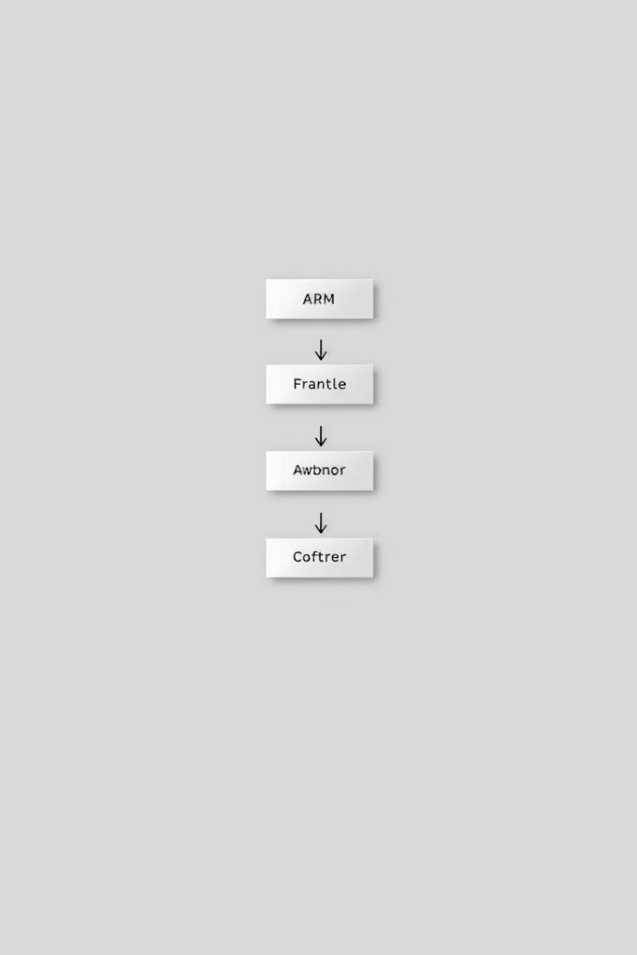

Instructions:
These are the fundamental operations that the processor can perform. Some common ARM instructions include:
Data processing instructions:
Arithmetic (ADD, SUB, MUL), logical (AND, OR, XOR), comparison (CMP), and move (MOV) instructions.
Load/Store instructions:
LDR (load register), STR (store register)
Branch instructions:
B (branch), BL (branch and link), BX (branch exchange)
Control flow instructions:
Conditional execution, loops, and function calls.

Slide 7


Programming Techniques :
A loop in ARM assembly is created using labels and conditional branches
MOV R0, #10 ; Initialize counter to 10
loop:
SUBS R0, R0, #1 ; Decrement counter
BNE loop ; If counter not zero, branch back to loop
Subroutines in ARM are written using BL to branch with a link, and BX LR to return:
BL my_function ;Call the subroutine
;Continue main code
my_function:
Subroutine code here
BX LR ; Return from subroutine

Slide 8

The stack is essential for storing temporary values, especially for recursive calls and local variables.
ARM uses PUSH and POP:
PUSH {R0, R1} ;Save R0 and R1 on the stack
; Perform operations
POP {R0, R1} ; Restore R0 and R1

Slide 9

Conclusion:
By mastering these fundamental concepts and techniques, you can effectively write ARM assembly code for a wide range of applications, from embedded systems to high-performance computing.

Slide 10


